Slide 1

算法分析与设计
Analysis and Design of Algorithms
山东大学 · 软件学院
2017年

Slide 2
22 Applications of Depth-First Search
Topological Sort
-- (for directed acyclic graph)
Strongly Connected Components Decomposing
-- (for directed graph)

Slide 3
1. Topological Sort
Directed acyclic graph (abbreviated as dag) are used in many applications to indicate precedences among events or objects.
A topological sort of a directed acyclic graph G = (V, E) is a linear ordering of all its vertices such that if G contains an edge (u, v), then u appears before v in the ordering.
1
2
1
3
4
2
3
4
How about if G contains a cycle?

Slide 4
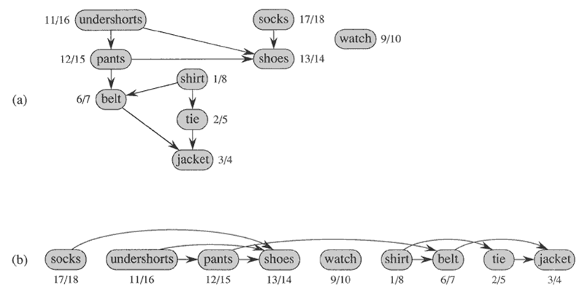
Application--Dressing Up

Slide 5
Topological Sort Problem
The problem
Input: A directed acyclic graph G = (V, E).
Output: A topological order of all the vertices of G.

Slide 6
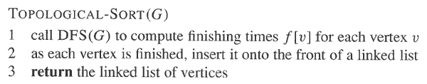
The Algorithm

Slide 7
Example
A
B
D
C
E
Linked List:

Slide 8
A
B
D
1/
C
E
Linked List:

Slide 9
A
B
D
1/
2/
C
E
Linked List:

Slide 10
A
B
D
1/
2/3
C
E
Linked List:
2/3
E

Slide 11
A
B
D
1/4
2/3
C
E
Linked List:
1/4
2/3
D
E

Slide 12
A
B
D
5/
1/4
2/3
C
E
Linked List:
1/4
2/3
D
E

Slide 13
A
B
D
5/
1/4
6/
2/3
C
E
Linked List:
1/4
2/3
D
E

Slide 14
A
B
D
5/
1/4
6/7
2/3
C
E
Linked List:
6/7
1/4
2/3
C
D
E

Slide 15
A
B
D
5/8
1/4
6/7
2/3
C
E
Linked List:
5/8
6/7
1/4
2/3
B
C
D
E

Slide 16
A
B
D
9/
5/8
1/4
6/7
2/3
C
E
Linked List:
5/8
6/7
1/4
2/3
B
C
D
E

Slide 17
A
B
D
9/10
5/8
1/4
6/7
2/3
C
E
Linked List:
9/10
5/8
6/7
1/4
2/3
A
B
C
D
E

Slide 18
Application--Dressing Up

Slide 19
Time Complexity
Time Complexity Analysis:
Line 1: Θ(V + E)
Line 2: Θ(V)
Line 3: Θ(1)
Total: Θ(V + E)

Slide 20
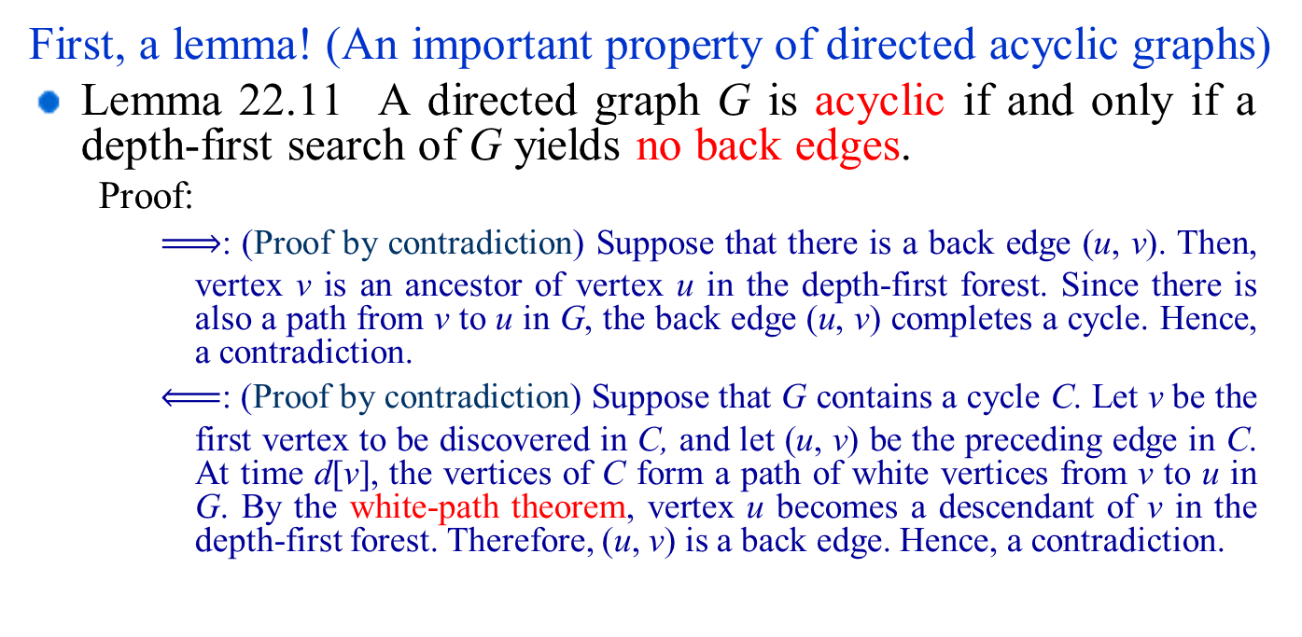
Correctness Proof of the Algorithm
First, a lemma! (An important property of directed acyclic graphs)
Lemma 22.11 A directed graph G is acyclic if and only if a depth-first search of G yields no back edges.
Proof:
: (Proof by contradiction) Suppose that there is a back edge (u, v). Then, vertex v is an ancestor of vertex u in the depth-first forest. Since there is also a path from v to u in G, the back edge (u, v) completes a cycle. Hence, a contradiction.
: (Proof by contradiction) Suppose that G contains a cycle C. Let v be the first vertex to be discovered in C, and let (u, v) be the preceding edge in C. At time d[v], the vertices of C form a path of white vertices from v to u in G. By the white-path theorem, vertex u becomes a descendant of v in the depth-first forest. Therefore, (u, v) is a back edge. Hence, a contradiction.

Slide 21
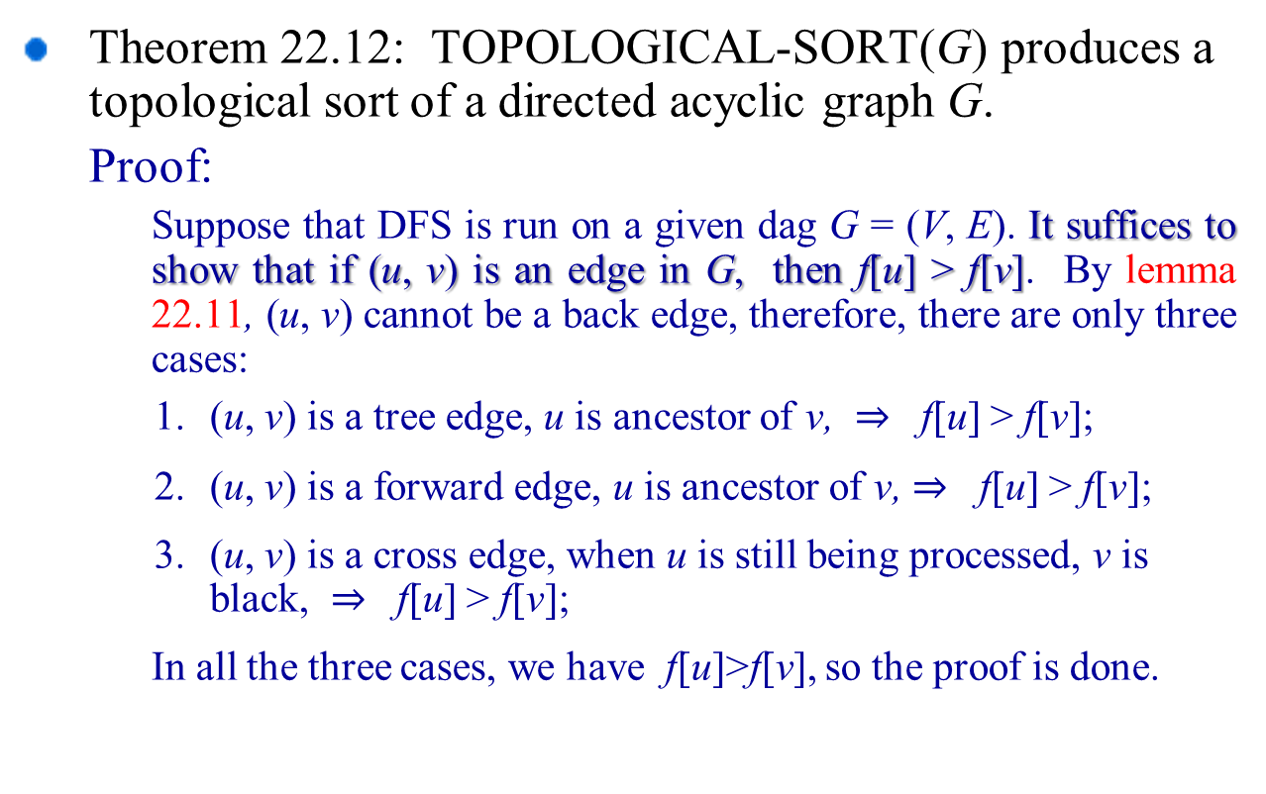
Correctness Proof of the Algorithm
Theorem 22.12: TOPOLOGICAL-SORT(G) produces a topological sort of a directed acyclic graph G.
Proof:
Suppose that DFS is run on a given dag G = (V, E). It suffices to show that if (u, v) is an edge in G, then f[u] > f[v]. By lemma 22.11, (u, v) cannot be a back edge, therefore, there are only three cases:
(u, v) is a tree edge, u is ancestor of v, f[u] > f[v];
(u, v) is a forward edge, u is ancestor of v, f[u] > f[v];
(u, v) is a cross edge, when u is still being processed, v is black, f[u] > f[v];
In all the three cases, we have f[u]>f[v], so the proof is done.

Slide 22
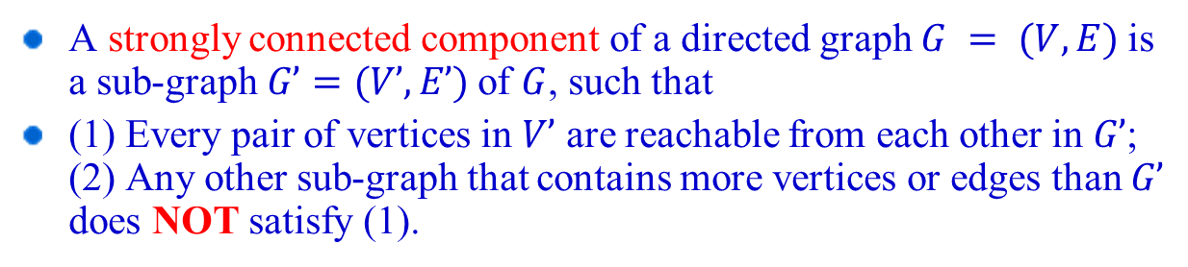
2. Strongly Connected Components Decomposing
A strongly connected component of a directed graph $G = (V, E)$is a sub-graph $G’=(V’, E’)$of $G$, such that
(1) Every pair of vertices in $V’$ are reachable from each other in $G’$; (2) Any other sub-graph that contains more vertices or edges than $G’$ does NOT satisfy (1).
2
Is {1,2,3} a strongly connected component?
Is {1,2,3,4} a strongly connected component?
And {5}?
1
3
4
5

Slide 23
The Strongly Connected Components Decomposition Problem
The problem:
Input: A directed graph G = (V, E).
Output: All the strongly connected components of G.
Two notes:
Strongly Connected Component = SCC.
In practice, many algorithms that work with directed graphs begin with a strongly connected components decomposition.

Slide 24
An Example
Give all SCCs of the following graph
Give a DFS forest of the following directed graph
a
d
b
c
g
e
f

Slide 25
Observations
1/8
a
9/14
d
b
2/7
10/11
12/13
3/4
c
g
e
肿么办……?
f
5/6
Observation: Running DFS algorithm on the original graph alone, we can’t find all SCCs correctly.

Slide 26
Transpose of a directed graph G
Definition:
Given a directed graph G = (V, E), the transpose of G is the graph G^{T}=(V, E^{T}), where E^{T}={(v, u)| (u, v)∈E}.
v₄
v₅
v₆
v₄
v₅
v₆
v₁
v₂
v₃
v₁
v₂
v₃
G
G^{T}
Given an adjacency-list representation of G, the time to create G^{T} is Θ(V + E).
Why?

Slide 27
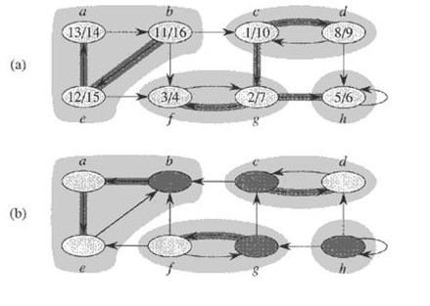
Relationship Between G and G^{T}
Given a directed graph G = (V, E), G and G^{T} have exactly the same strongly connected components

Slide 28
The Component Graph
The component graph G^{SCC} = (V^{SCC}, E^{SCC}) of a directed graph G = (V, E) is defined as follows:
Suppose that G has strongly connected components C₁, C₂, …, C_{k}:
the vertex set V^{SCC} = {v_{i} | v_{i} corresponds to component C_{i} of G, i = 1,2, …, k}
the edge set E^{SCC} = {(v_{i}, v_{j}) | G contains a directed edge (x, y) for some x ∈ C_{i} and some y ∈ C_{j} , i, j = 1, 2 , …, k}

Slide 29
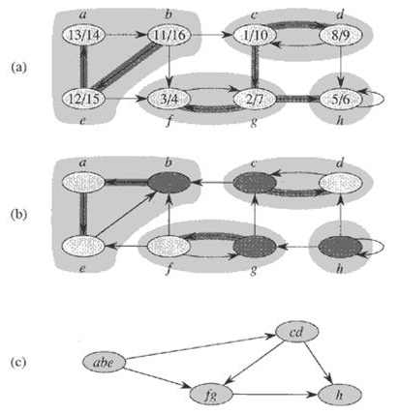
The Component Graph
(a): The graph G with its SCCs shaded
(b): The transpose G^{T} of G with SCCs shaded
(c): The component graph G^{SCC} = (V^{SCC}, E^{SCC}) of G

Slide 30
Property of The Component Graph
The component graph G^{SCC} = (V^{SCC}, E^{SCC}) is a directed acyclic graph. (Lemma 22.13)
Proof: (by contradiction) Suppose that G^{SCC} is cyclic, that is, there exist two vertices v₁, v₂ ∈V^{SCC} such that v₁ and v₂ are reachable from each other.
Next, suppose v₁ and v₂ represent the two strongly connected components C₁ and C₂ of G respectively.
Then according to the definition of component graph, vertices in C₁ and C₂ are reachable from each other, which contradicts with the definition of strongly connected component.

Slide 31

Property of G^{SCC}
Property of The Component Graph
v₄
v₅
v₆
G
G^{SCC}
u
v₁
v₂
v₃
Suppose the DAG (directed acyclic graph) on the right side is the G^{SCC} of some graph G
Now, suppose we perform DFS on G
let u be a node with largest finishing time
Question: Which SCC can u be located ?
(see next Lemma)

Slide 32
Property of G^{SCC}
Property of The Component Graph
Lemma:
Consider any graph G.
Let G^{SCC} be its component graph.
Suppose v is a vertex in G^{SCC} with at least one incoming edge.
Then, the node u finishing last in any DFS of G cannot be a vertex of the SCC corresponding to v

Slide 33
Proof
Property of The Component Graph
Let SCC(v) = SCC corresponding to v
Since v has incoming edge, there exists w such that (w,v) is an edge in G^{SCC}
Inside G^{SCC}
w
v
In the next two slides, we shall show that some node in SCC(w) must finish later than any node in SCC(v)
Consequently, u cannot be in SCC(v)

Slide 34
Proof
Property of The Component Graph
Inside G
Let x = 1st node in SCC(w) discovered by DFS
Let y = 1st node in SCC(v) discovered by DFS
Let z = last node in SCC(v) finished by DFS
// Note: z may be the same as y
z
x
y
SCC(w)
SCC(v)
By white-path theorem, we must have
d(y) ≤ d(z) < f(z) ≤ f(y)

Slide 35
Proof
Property of The Component Graph
Inside G
If d(x) < d(y)
then y becomes x’s
descendant (by white-path)
➔ f(z) ≤ f(y) < f(x)
If d(y) < d(x)
since x cannot be y’s
descendant (otherwise, they are in the same SCC)
➔ d(y) < f(y) < d(x) < f(x)
➔ f(z) ≤ f(y) < f(x)
z
x
y
SCC(w)
SCC(v)

Slide 36
Finding SCC
Property of The Component Graph
v₄
v₅
v₆
So, we know that u (last finished node of G) must be in an SCC with no incoming edges
Let us reverse edge directions, and start DFS on G^{T} from u
v₁
v₂
v₃
v₄
v₅
v₆
Question: Who will be u’s descendants ??
v₁
v₂
v₃
New G^{SCC}

Slide 37
Finding SCC
Property of The Component Graph
v₄
v₅
v₆
Note that nodes in the SCC containing u cannot connect to nodes in other SCCs in G^{T}
By white-path theorem, the descendants of u in G^{T} must be exactly those nodes in the same SCC as u
v₁
v₂
v₃
v₄
v₅
v₆
v₁
v₂
v₃
New G^{SCC}

Slide 38
Finding SCC
Property of The Component Graph
Once DFS on u inside G^{T} has finished, all nodes in the same SCC as u are finished
➔ Any subsequent DFS in G^{T} will be made as if this SCC was removed from G^{T}
Now, let u’ be the remaining node in G^{T} whose finishing time (in DFS in G) is latest
Where can u’ be located?
Who will be the descendents of u’ if we perform DFS in G^{T} now?
Notes:
u’ will be located in SCC without outgoing edge in G^{T}

Slide 39
Our observations lead to the following algorithm for finding all SCCs of G :
Finding-all-SCC(G) {
1. Perform DFS on G ;
2. Construct G^{T} ;
3. while (some node in G^{T} is undiscovered)
{ u = undiscovered node with latest finishing time** ;
Perform DFS on G^{T} from u ;
} // nodes in the DFS tree from u forms an SCC
} // ** Finishing times always refer to Step 1’s DFS

Slide 40
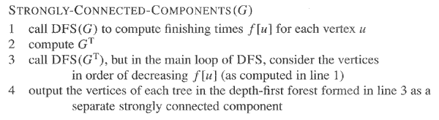
The Algorithm

Slide 41
SCC: Example

Slide 42
Run DFS(G) to compute finishing times for all u∈V

Slide 43
Run DFS(G) to compute finishing times for all u∈V

Slide 44
Run DFS(G) to compute finishing times for all u∈V

Slide 45
Run DFS(G) to compute finishing times for all u∈V
Vertices sorted according to the finishing times:
⟨b, e, a, c, d, g, h, f ⟩

Slide 46
Compute G^{T}

Slide 47
(3) Call DFS(G^{T}) processing vertices in main loop in decreasing f[u] order: ⟨b, e, a, c, d, g, h, f ⟩

Slide 48
(3) Call DFS(G^{T}) processing vertices in main loop in decreasing f[u] order: ⟨b, e, a, c, d, g, h, f ⟩

Slide 49
(3) Call DFS(G^{T}) processing vertices in main loop in decreasing f[u] order: ⟨b, e, a, c, d, g, h, f ⟩

Slide 50
(3) Call DFS(G^{T}) processing vertices in main loop in decreasing f[u] order: ⟨b, e, a, c, d, g, h, f ⟩

Slide 51
(3) Call DFS(G^{T}) processing vertices in main loop in decreasing f[u] order: ⟨b, e, a, c, d, g, h, f ⟩

Slide 52
(3) Call DFS(G^{T}) processing vertices in main loop in decreasing f[u] order: ⟨b, e, a, c, d, g, h, f ⟩

Slide 53
(3) Call DFS(G^{T}) processing vertices in main loop in decreasing f[u] order: ⟨b, e, a, c, d, g, h, f ⟩

Slide 54
(3) Call DFS(G^{T}) processing vertices in main loop in decreasing f[u] order: ⟨b, e, a, c, d, g, h, f ⟩

Slide 55
(4) Output vertices of each DFT in DFF as a separate SCC
C_{c}={c,d}
C_{b}={b,a,e}
C_{g}={g,f}
C_{h}={h}

Slide 56
C_{c}
C_{b}
C_{g}
C_{h}

Slide 57
Correctness Proof of the Algorithm
The correctness of the algorithm can be proven by induction
(Hint: Show that at each sub-search in Step 3, u is chosen from an SCC which has no outgoing edges to any nodes in an “unvisited” SCC of G^{T}.
➔ By white-path theorem, exactly all nodes in the same SCC become u’s descendants)

Slide 58
SCCs and DFS Finishing Times
Extension of the notation for d[] and f[] to sets of vertices
If U ⊆ V, define
d[U] = min_{u∈U}{d[u]}, the discovery time of vertex set U, that is, the earliest discovery time of any vertex in U;
f[U] = max_{u∈U}{f[u]}, the finishing time of vertex set U, that is, the latest finishing time of any vertex in U.

Slide 59
SCCs and DFS finishing times
Lemma 22.14
Let C and C′ be distinct SCC’s in G = (V, E). Suppose there is an edge (u, v) ∈ E such that u ∈ C and v ∈C′. Then f (C) > f (C′).
Proof:
Case 1: d(C) < d(C′)
Let x be the first vertex discovered in C.
At time d[x], all vertices in C and C′ are white. Thus, there exist paths of white vertices from x to all vertices in C and C′.
By the white-path theorem, all vertices in C and C′ are descendants of x in depth-first tree.
By the parenthesis theorem, we have
f [x] = f (C) > f(C′).
C
C’
u
v
x

Slide 60
SCCs and DFS finishing times
Lemma 22.14
Let C and C′ be distinct SCC’s in G = (V, E). Suppose there is an edge (u, v) ∈ E such that u ∈ C and v ∈C′. Then f (C) > f (C′).
Proof:
Case 2: d(C) > d(C′)
Let y be the first vertex discovered in C′.
At time d[y], all vertices in C′ are white and there is a white path from y to each vertex in C′ ⇒ all vertices in C′ become descendants of y. Again, f [y] = f (C′).
At time d[y], all vertices in C are also white.
By earlier lemma, since there is an edge (u, v), we cannot have a path from C′ to C.
So no vertex in C is reachable from y.
Therefore, at time f [y], all vertices in C are still white.
Therefore, for all w ∈ C, f [w] > f [y], which implies that f (C) > f (C′).
C
C’
u
v
w
y

Slide 61
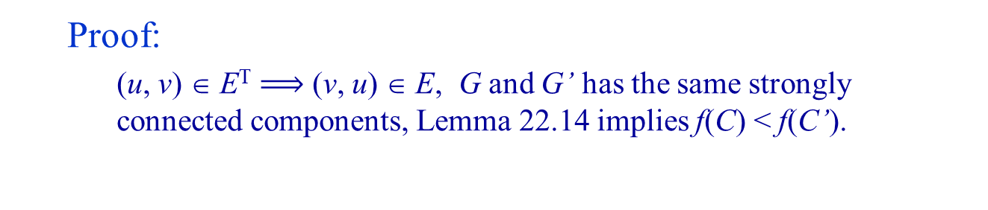
SCCs and DFS finishing times
Lemma 22.14
Let C and C′ be distinct SCC’s in G = (V, E). Suppose there is an edge (u, v) ∈ E such that u ∈ C and v ∈C′. Then f (C) > f (C′).
Corollary 22.15
Let C and C′ be distinct SCC’s in G = (V, E). Suppose there is an edge (u, v) ∈ E^{T} such that u ∈ C and v ∈C′. Then f (C) < f (C′).
Proof:
(u, v) ∈ E^{T} (v, u) ∈ E, G and G’ has the same strongly connected components, Lemma 22.14 implies f(C) < f(C’).

Slide 62
The Algorithm

Slide 63
Correctness Proof of the Algorithm
Theorem 22.16 STRONGLY-CONNECTED-COMPONENTS(G) correctly computes the strongly connected components of a directed graph G.

Slide 64
Correctness Proof of the Algorithm (informal)
When we do the second DFS, on G^{T}, start with SCC C such that f(C) is maximum.
The second DFS starts from some x ∈ C, and it visits all vertices in C.
Corollary 22.15 says that since f(C) > f (C′) for all C ≠ C′, there are no edges from C to C′ in G^{T}.
Therefore, DFS will visit only vertices in C.
Which means that the depth-first tree rooted at x contains exactly the vertices of C.

Slide 65
Correctness Proof of the Algorithm (informal)
The next root chosen in the second DFS is in SCC C′ such that f (C′) is maximum over all SCC’s other than C.
DFS visits all vertices in C′, but the only edges out of C′ go to C, which we’ve already visited.
Therefore, the only tree edges will be to vertices in C′.
We can continue the process.
Each time we choose a root for the second DFS, it can reach only
vertices in its SCC—get tree edges to these,
vertices in SCC’s already visited in second DFS—get no tree edges to these.

Slide 66
Proof of Theorem 22.16
Proof: we will prove that the vertices of each tree form a strongly connected component, by induction on the number k of depth-first trees found in the depth-first search of G^{T} in line 3.
Basic step: k = 0, it is trivially true.
Inductive hypothesis: the first k trees produced in line 3 are strongly connected components.
Inductive step: Consider the (k+1)st tree produced.
Let the root of the (k+1)st tree be vertex u, and let u be in strongly connected component C. By induction hypothesis, no vertices in C had been searched before, and since u has the biggest f[] among all the remaining vertices in G^{T}, f[u] = f[C] > f[C’] for any strongly connected component C’ other than C that has yet not been visited.
At time d[u], all other vertices of C are white. By the white-path theorem, all other vertices of C are descendants of u in its depth-first tree.
Moreover, by induction hypothesis, Corollary 22.15 and f[C] > f[C’] got above, any edge in G^{T} that leaves C must point to SCCs that have already been visited. Thus, no vertex in any SCC other than C will be a descendant of u during the depth-first search of G^{T}.
Thus, the vertices of the depth-first tree in G^{T} that is rooted at u form exactly one strongly connected component

Slide 67
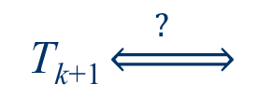
Proof (Continued)
C₁
T₁
C₂
T₂
……
C_{k}
T_{k}
T_{k+1} $\underset{⇔}{ ? }$
C
u
……

